Slide 1

INSTACART ORDERS
Analysis of Instacart Orders data
By: Swati Chaurasia

Slide 2
Data Mining
Data has been taken from Kaggle for the year 2017.
Whole data is divided into five datasets and there are no null values in any of the dataset.

Slide 3

Introduction
Instacart is an online grocery delivery service company that works with local stores to deliver groceries to your door. Through it, customers can select groceries online through a web application and within a couple of hours(or a timeframe of one’s choice ), the order gets delivered to the personal shopper.

Slide 4
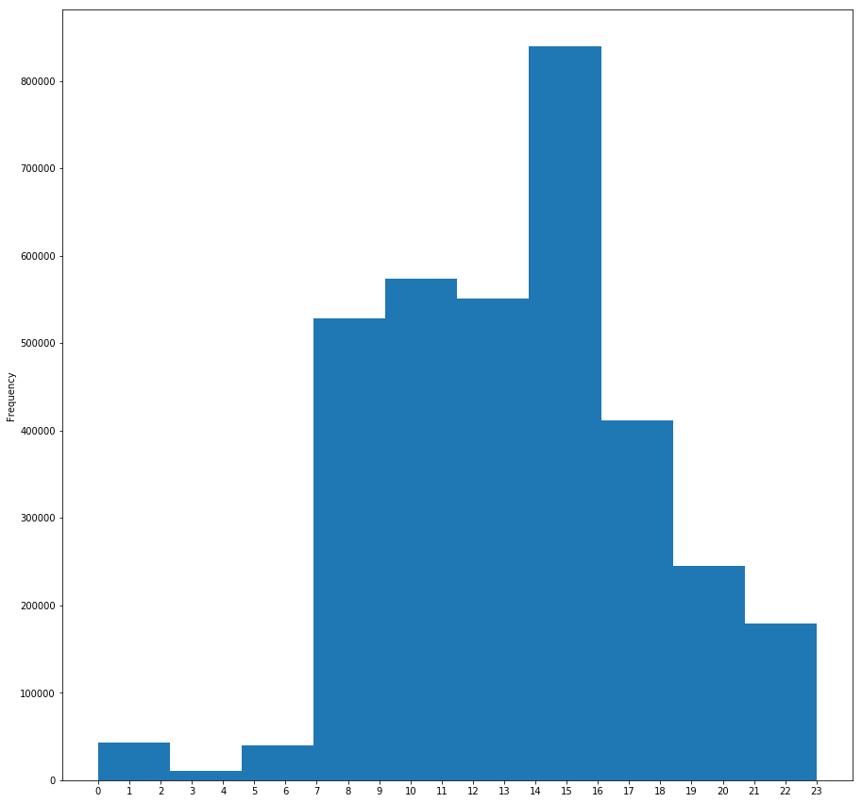
DATA INTERPRETATION
When do people order?
There is a clear effect of hour of day on order . Most orders are between 7.00-16.00 .
So we can conclude that most of the orders have taken place during the day time.

Slide 5
Data Collected:
Total aisles :134
Total departments :21
Total products : 49688

Slide 6
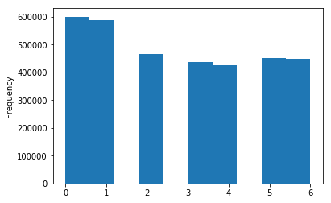
Day-of-Week
There is clear effect of day_of_week, on the orders. Most of the products have been ordered on days 0 and 1, but as we don’t have information of which value represents which day, we may assume that it is weekend.

Slide 7
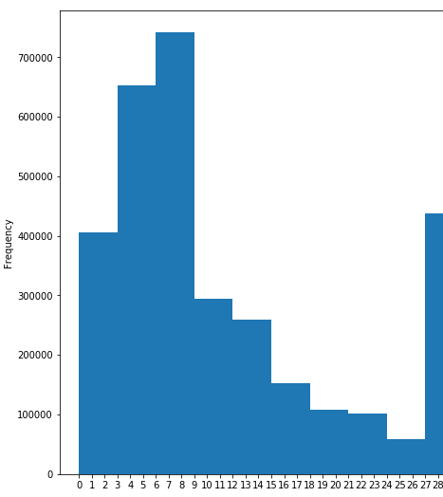
When do they order again?
People seem to order more often after about 9 days or approximately a week again from the prior order day.

Slide 8
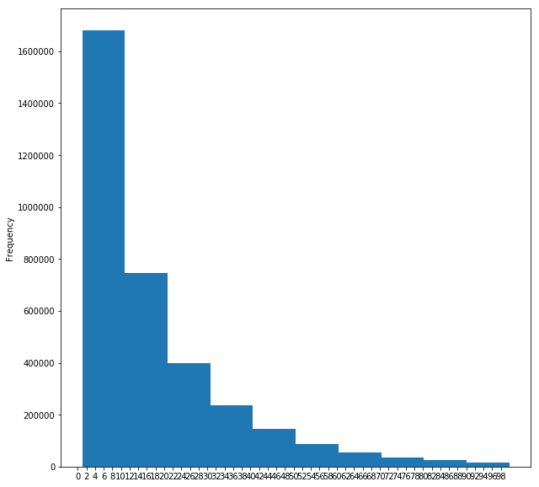
How many prior orders are there?
We can see that there are always at least 1 prior orders .
From this we may assume that people are familiar with this website(Instacart) and use it for their needs.

Slide 9
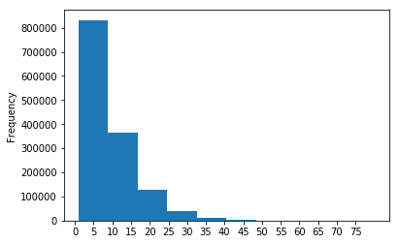
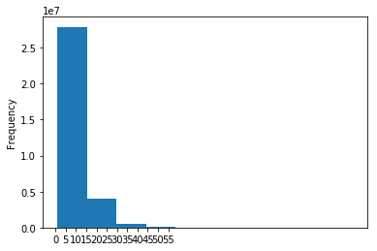
How many items do people buy?
From the data taken from recent orders of few customers , we can see that people most often order around 5 to 7 items ..
Data taken from the previous orders set shows that usually 10 to 15 items are ordered by customers.

Slide 10
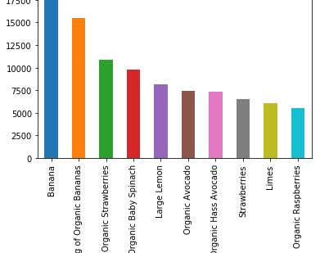
Most frequently ordered products
From bar plot we conclude that fruits like banana , strawberries ..etc are the most frequently ordered items.

Slide 11
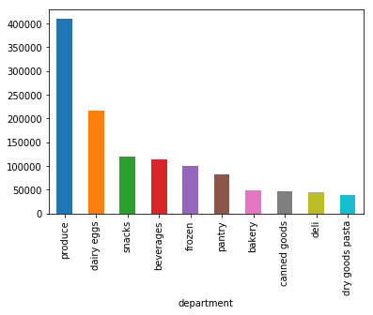
Top Selling Product Departments
From chart we conclude that most of the ordered items belong to following departments I.e produce, dairy eggs etc.

Slide 12
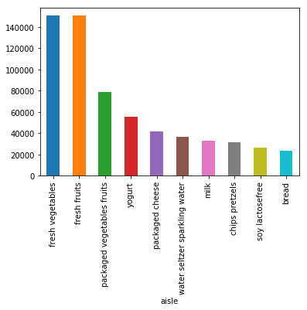
Top Selling Product Aisles
Most of the products belong to fresh vegetables and fresh fruits.

Slide 13
CONCLUSION
No overlap between users from train and test set
test: 75000 users, 1242497 orders, 16.566626666666668 orders per user
train: 131209 users, 2178586 orders, 16.60393722991563 orders per user

